Slide 1
SENTINEL URL
CSD 334-MINI PROJECT
GUIDED BY:
PROF. JOSMY GEORGE
ASSOCIATE PROFESSOR
DEPARTMENT OF COMPUTER SCIENCE AND ENGINEERING
PREPARED BY:
JOEL JOHN GEORGE
JISHNU SHAJI
MATHEW VARGHESE
KEVIN B VAROOR

Slide 2

VISION
To become an excellent department by empowering the graduates to address the challenges in the fast changing scenario, adhering to ethical values.
MISSION
• Inculcate skills to solve complex engineering problems and instill entrepreneurial capabilities.
• Equip the students to advance with the recent trends and technology through Research and Innovations in the field of computer science.
• Facilitate the development of professional behavior, ethical values and the spirit of service to the society.

Slide 3
ABSTRACT
SentinelURL– Intelligent Phishing Detection System
Phishing attacks are everywhere these days, and they trick people into going to bad websites that grab personal info like passwords or credit card numbers. It’s scary how often this happens. SentinelUrl is this web app we came across, meant to check if a URL is okay or not. It helps users figure things out fast without getting their own devices in trouble. The way it works involves a couple layers of checking the link. First off, there’s the static part where it looks at the domain stuff, like DNS records and if it has HTTPS set up right, plus it checks against lists of known bad sites from threat sources.Then it actually opens the URL in a safe sandbox, kind of like an isolated box, and watches what the site does—things like redirects, what networks it talks to, any scripts running, even the visuals on the page. It feels like that’s where it gets more real about the behaviour. Putting all that together, the app spits out a threat score and a report that’s supposed to be straightforward, explaining if the link’s safe or suspicious or straight-up malicious. Users can decide based on that without the risk. Overall, SentinelUrl tries to make browsing safer by catching phishing early.

Slide 4
PROBLEM STATEMENT
The phishing attacks are carried out using URLs with malicious intent to steal valuable information from users.
Phishing sites look a lot like real sites. This makes it hard to spot them manually.
The earlier approaches lack comprehensive analysis and lack monitoring features for real-time behaviors.
The user is left without explanation or proof if the URL has been flagged.
A system is required that is capable of safely and reliably analyzing a given URL and pinpointing a phishing threat.

Slide 5
OBJECTIVES
To design an accurate phishing URL detection system.
The analysis of URLs should be done in a safe way, without putting users at risk.
To carry out static analysis using domain and threat‑intelligence checks.
To observe real‑time website behavior using sandbox execution.
To classify URLs into Safe, Suspicious, or Malicious.
To give clear reports with evidence to support this.

Slide 6
NEED FOR THE SYSTEM
Phishing attacks increase rapidly and attack users via malicious URLs.
People cannot be able to detect sites that seemingly look real yet are actually fake.
Existing tools only provide limited detection and are without real‑time behavior analysis.
This is why many systems do not provide clear reasons or evidence for detected threats.
A Need is felt for an approach that offers a secure, correct, and safe URL analysis.
A combined static and dynamic approach is necessary for successful phishing detection.

Slide 7
PROPOSED SYSTEM
User submits suspicious URL
Static Analysis without accessing a website: WHOIS, DNS, TLS, Threat Intelligence services
Detection of common phishing indicators
Secure sandbox execution of the URL
Detection of real-time behaviour (redirects, scripts, page actions)
Taking screenshots, network har logs, and DOM information
Mixed results obtained both statically and dynamically
Threat Score Calculation
Classification: Safe / Suspicious / Malicious
Production of an accurate and evidence-based report

Slide 8
SOFTWARE REQUIREMENTS
OS: Linux / Windows / macOS
Language: Python 3.9+
Backend: FastAPI
Static Analysis: Python Regex, WHOIS, DNS tools
Sandbox: Docker, Playwright
Async Tasks: Redis, Celery / RQ
Database: PostgreSQL
Storage: S3
CI/CD: Git, GitHub Actions, Bash

Slide 9
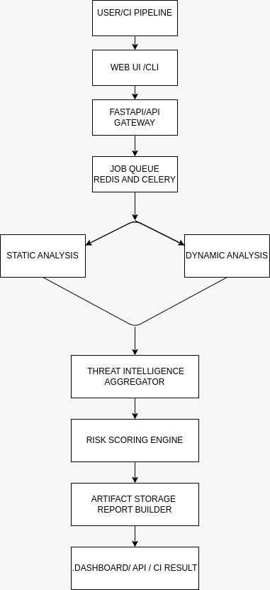
SYSTEM ARCHITECTURE

Slide 10
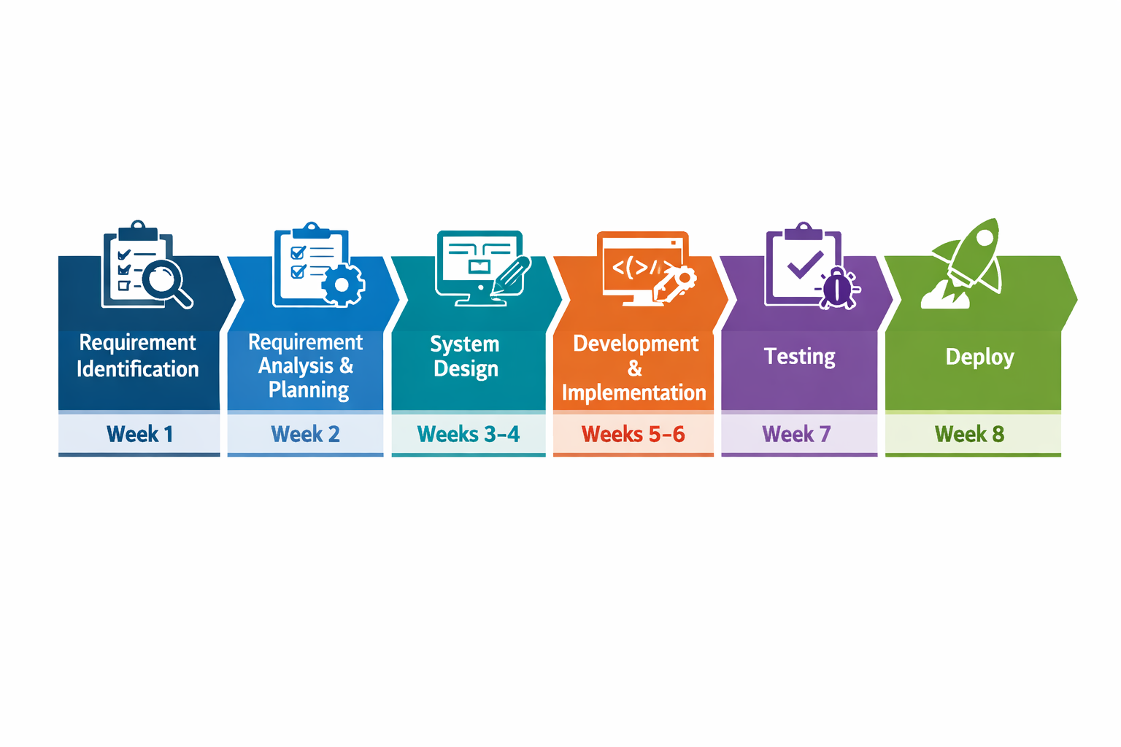
WORK PLAN
Requirement Identification
Requirement Analysis and planning
Development and implementation
System design
Testing
Deploy

Slide 11
CONCLUSION
Phishing attacks are still one of the common cybersecurity threats that use malicious URLs to deceive victims and harvest critical information. SentinelUrl is an effective mechanism that tackles the menace by utilizing static analysis and dynamic sandbox analysis to test the links. Through the observation of the live activities on the website and the information on the domains and threat intelligence, the mechanism increases the accuracy levels of phishing attacks. The pronounced level of the threat alongside the evidence of the captures helps the user make informed decisions. SentinelUrl is an efficient way that has improved cybersecurity.

Slide 12
THANK YOU

